Slide 1


Training on GEOUNED tool
J.P. Catalán, P. Sauvan and TECF3IR group
Energy Engineering Department.
Nuclear Engineering Area
Universidad Nacional de Educación a Distancia (UNED), Madrid, Spain

Slide 2
Introduction

Slide 3



GEOUNED code description
GEOUNED is a new conversion tool to convert CAD (B-rep) ↔ MC (CSG).
  Based on FreeCAD as interface for Open CASCADE CAD engine. Both tools are open source and actively supported.
  GEOUNED is open source located in GitHub.
  Programmed in Python 3. Used as script launched in a system console:
    Automatization of repetitive/complex tasks (comments, density factors)
    Extension of capabilities ⇒ high adaptability to specific problems
  Automatic void generation ⇒ essential for complex models
    Complex enclosure shapes for void generation based on CAD solids => structured hierarchical voids producing cleaner inputs
OPEN
CASCADE

Slide 4
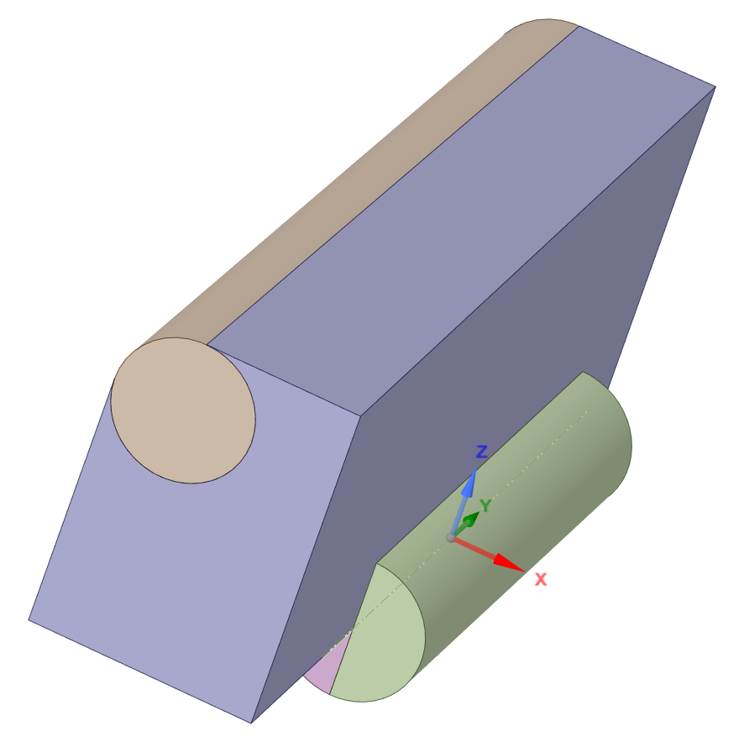
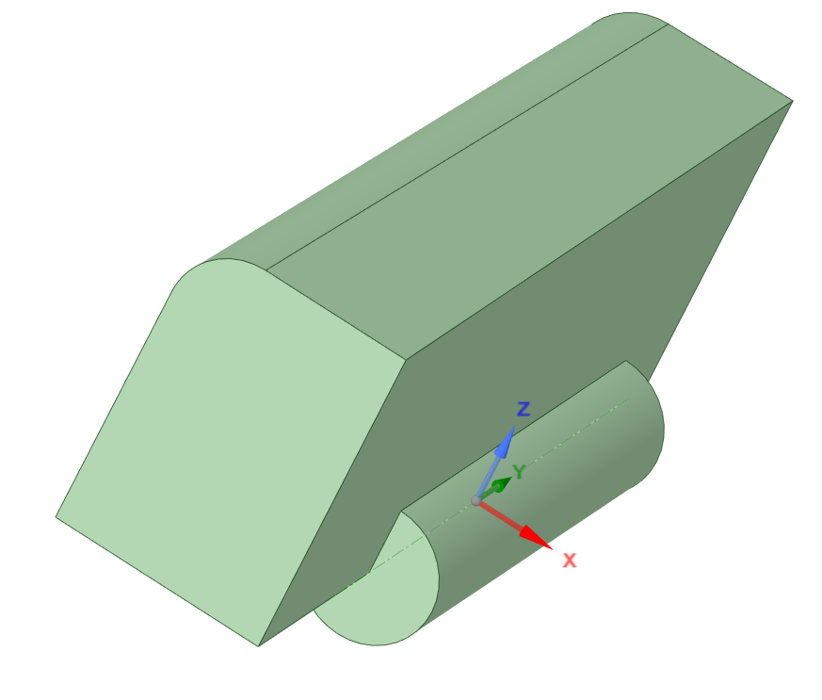
GEOUNED Decomposition/Converted algorithms
Solids are decomposed/converted using the most common surfaces used in MCNP: planes, cylinders, cones, spheres and torii.

Slide 5
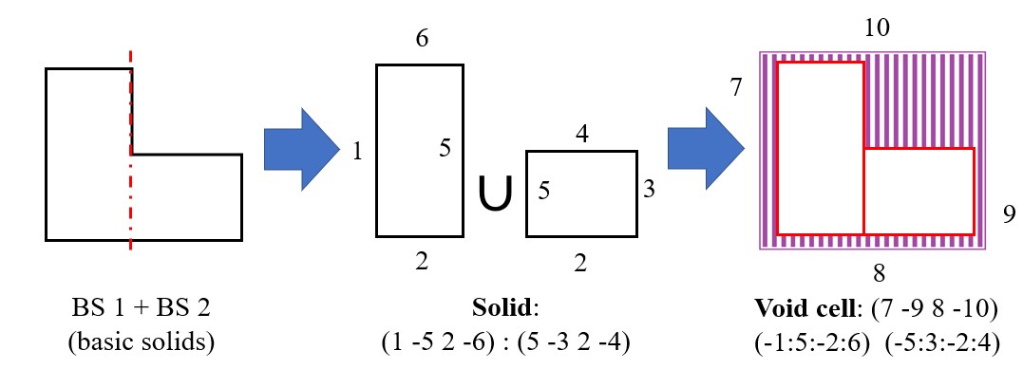
GEOUNED automatic void generation algorithm
The automatic void generation of GEOUNED is based on boolean expressions.
Interference function in necessary to know the solids that are within a void region.
  ‘Real’: intrinsic OpenCASCADE CAD interference. Optimum but ↑#errors
  ‘Pseudo’: home-made algorithm. Less optimum but faster and ↑ stable
Control of void complexity by user criteria: #surfaces, #basic solids, volume min.

Slide 6
Installation and Execution
Windows and Linux

Slide 7
Installation methods
2 Options :
FreeCAD + GEOUNED + Dependencies
individual installation of all the components
Required python version compatible with FreeCAD (currently python 3.8)
or
Conda
GEOUNED, FreeCAD and all dependencies, installed jointly
No python restriction (use a FreeCAD package compiled for the Conda python version)

Slide 8
Installation Option 1
Install FreeCAD obtain from https://freecad.org
Install GEOUNED :
Directly from GitHub repository: https://github.com/GEOUNED-code/GEOUNED
Or via pip
pip install git+https://github.com/GEOUNED-code/GEOUNED.git
Or using git
git clone -b dev https://github.com/GEOUNED-code/GEOUNED.git
Install geouned dependency libraries:
numpy
tqdm

Slide 9
Installation Option 2
Install GEOUNED with Conda
I don’t know how it works ask A. Cubi, A. Kolsek, or J. Shimwell

Slide 10
Execution of GEOUNED
GEOUNED can be launch with the command line “geouned” (https://github.com/GEOUNED-org/utilities), or making your own script python using geouned API (recommended).
Using the command line tool, parameters are provided through a json file.

Slide 11
Execution of GEOUNED (command line)
The command line execution is : geouned -i inputfilename
inputfilename : name of the json file
Example of json file
{
"load_step_file": {
"filename": “mymodel.stp",
"skip_solids": []
},
"Settings": {
"compSolids": false,
"simplify": "no",
"minVoidSize": 200.0,
"startCell": 10,
"startSurf": 100
},
"export_csg":{
"title": "Converted with GEOUNED",
"geometryName": “mymodel",
"outFormat": ["openmc_xml", "mcnp"]
}

Slide 12
Execution of GEOUNED (API)
Code parameters are passed through classes, and geouned methods
Configuration Classes
Conversion Class
Settings : General settings used during conversion
Options : Specific options to change features in the conversion process
Tolerances : Tolerances between surfaces (define if identical or not)
NumericFormat : Numerical format of surface parameters in the output file
CadToCsg: conversion from CAD to CSG
CadToCsg methods
load_step_file : load the step input file
export_csg : write converted CSG file

Slide 13
Execution of GEOUNED (API)
Minimal GEOUNED script
Configuration classes would be passed when CadToCsg is called
import geouned
geo = geouned.CadToCsg()
geo.load_step_file(filename = “mystepfile.stp”)
geo.start()
geo.export_csg(geometryName=“myCSG”,
outformat = (‘mcnp’,) )
Start the conversion process

Slide 14
CadToCSG methods
load_step_file(filename='cuboid.stp’,
skip_solids = [0,2],
spline_surfaces: ‘stop’,
)
filename : name of the stp file (str)
skip_solids : list of solids to not load for the conversion (tuple, list).
The index of solid must be provided.
spline_surfaces : code behavior if spline surfaces are found in solids (str) !new in version 1.6.0
allowed values :
stop : the execution will stop if spline surfaces is found in at least one solid
remove : the solid with spline surfaces will not be translated
ignore : the solid will be translated like other solids. May lead to translation errors

Slide 15
CadToCSG methods
export_csg(title=‘title of the model’,
geometryName = ‘csg_model’,
outFormat = (‘mcnp’, ),
volSDEF = True,
volCARD = False,
UCARD = 100,
dummyMat = True,
cellCommentFile = False,
cellSummaryFile = False,
)
title : Title of the converted model (str)
geometryName : Base name of the CSG output file
outFormat : Format for the output geometry (‘mcnp’, ‘openmc_xml, …)
volSDEF : For mcnp output format, write the SDEF definition to run stochastic volume control
volCARD : write CAD volume of solid cells in the cell definition
UCARD : write the universe number in each cell definition
dummyMat : For mcnp output format, write dummy material definition cards for materials defined in the model
cellCommentFile : Write an additional file with comment associated to each CAD cell in the MCNP output file
cellSummaryFile : Write an additional file with information on the CAD cell translated

Slide 16
GEOUNED Classes
Instance of CadToCsg class:
geo = geouned.CadToCsg(Settings = mySettings,
Options = myOptions,
Tolerances = myTolerances,
NumericFormat = myNumeric,
)
mySettings, myOptions, myTolerances, myNumerics : specific instances of the geouned class to change default parameters of the conversion process

Slide 17
GEOUNED Settings Classes
Instance of Settings class. Used to setting specific arguments to the conversion process
outPath : name of the folder to write all generated output files and folders ! New in 1.6
matFile : Name of the file where material information is stored (material number, density, comments)
debug : If True, write decomposed solids CAD
compSolid : Join subsolids of STEP file as a single compound solid.
simplify : simplify boolean cell definition. Available options (“no”, “void”, “voidfull”, “full”)
minVoidSize : minimal size of the void cells (in mm)
voidMat : material assigned to generated voids.
mySettings = geouned.Settings(outPath = ‘outfolder’,
matFile = ‘materials’,
debug = False,
compsolid = False,
simplify = ‘full’
minVoidSize = 200,
voidMat = [100, 1.2e-3, ’Air’],
startCell = 10001,
startSurf = 10001,
sortEnclosure = False,
)
sortEnclosure : if True and enclosures are defined, enclosure cells will be located in the output file at the same locate where the enclosure cells are defined

Slide 18
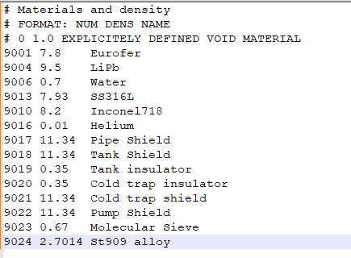
Materials definition
Material number, density and name are defined in a file
Materials are assigned in the CAD tree
Key text for material _mXX_dYY.YY_
XX number of material
YY.YY dilution/density correction factor (optional)

Slide 19
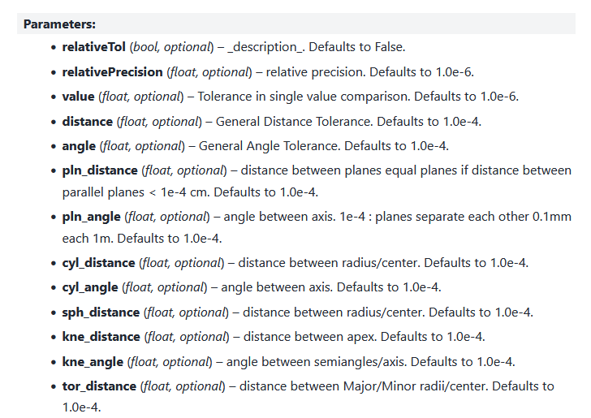
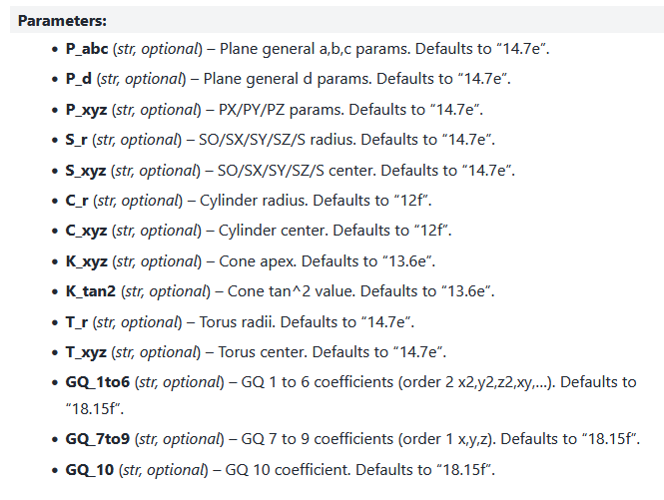
Other GEOUNED configuration classes
geouned.Options() : Advanced conversion options, do not change
geouned.Tolerances() : Used to defined the threshold to decide whether two surfaces are identical or not. Each type of surfaces tolerances can be defined independently.
NumericFormat : Numerical format of surface parameters in the output file. Each surface and type of parameters can be set independently

Slide 20
CSG to CAD
Only for version 1.6

Slide 21
Execution of GEOUNED (API)
Minimal GEOUNED script
import geouned
geo = geouned.CsgToCad()
geo.read_csg_file(“csgmodel”, “mcnp”)
geo.build_universe()
geo.export_cad()
Universe dimensions is no longer required

Slide 22
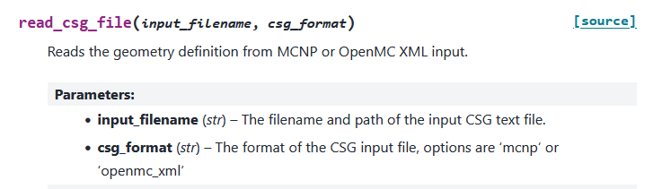
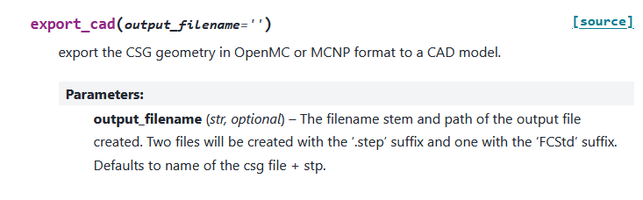
CsgToCad methods

Slide 23
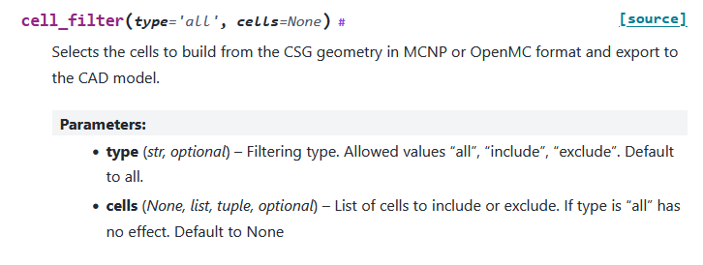
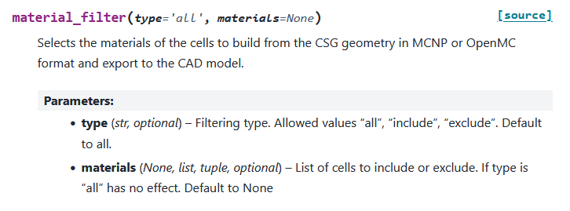
CsgToCad methods

Slide 24
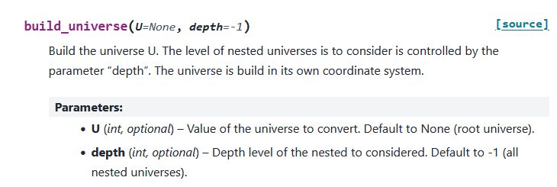
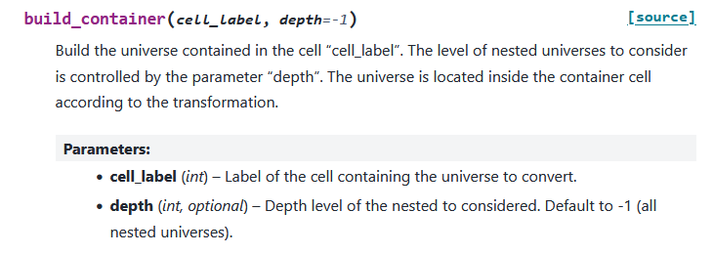
CsgToCad methods
If the universe number is specified, the universe will be built in its own coordinate system
The universe is built and moved following universe translation information provided by the container cell

Slide 25
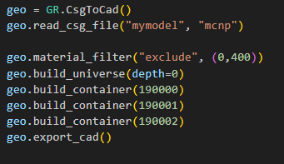
CsgToCad example
Exclude all cells with 0 or 400 material index
Build only cell in the root universe
Build universes contained in container cells 190000, 190001, 190002
Export all the converted solids

Slide 26
Model preparation
Good practices

Slide 27
Preparation of CAD neutronic model
The CAD neutronic model should be suitable for conversion:
The surface types are restricted to those supported by MC codes*.(mandatory)
  *Up to second order surfaces & tori with axis parallel to X, Y and Z axis
No interferences between solids. (desirable)
Reduction of unnecessary complexity. (desirable)

Slide 28
Preparation of CAD neutronic model
In some model problems may appear during the conversion due to bad step file format produced by the CAD tool (SpaceClaim).
Some solids in STEP format in SpaceClaim are not saved properly. This can be detected by opening the solid in FreeCAD.
Solution: Save the model in IGS format, open it in SpaceClaim and save again in STEP format.
Solids with very small details and faces (with no sense from the point of view of the neutronic analysis)
Solution: Running the SpaceClaim functions Split Edges, Extra Edges, Small Faces and Inexact Edges until all tests give you 0 problems.
3. Similar surfaces that produces lost particles.
Solution: GEOUNED can handle part of this kind of surfaces by modifying the tolerances and number formats. This also can be managed by using replace surface function of SpaceClaim to be sure that the surface are the same.

Slide 29
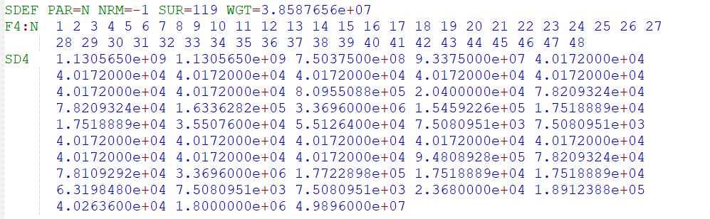
Automatic model verification
Automatic SDEF and Tally definition for statistical volume calculation
GEOUNED source and tally definition
CAD neutronic model
GEOUNED
+
Material list file (ID, density, comment string)
MCNP input
MCNP
MCNP Volume table ratio
Tally normalized by CAD volume
Lost particles
table

Slide 30
Void generation
Enclosures & envelopes

Slide 31
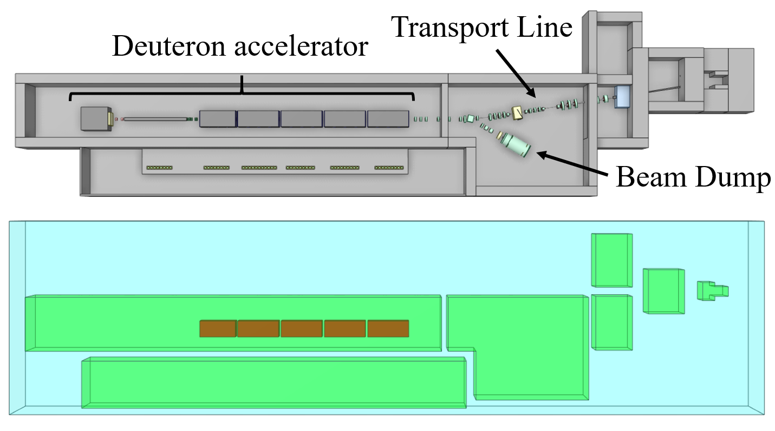
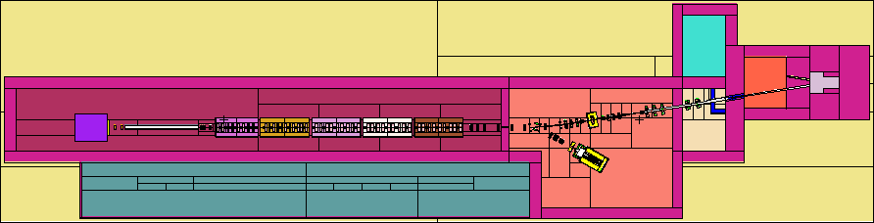
Enclosures and envelopes
IFMIF-DONES: complex void structure
CAD solids can be used to void generation (enclosures) or exclusion regions (envelopes).
Nested structure of the enclosures (several levels) can be defined
  1st level: outermost enclosure
  2nd level: room enclosures
  3rd level: Superconducting Radio Frequency Modules
Structured hierarchical voids producing cleaner inputs
Easy material assignment
Hierarchical nested enclosure structure
IFMIF-DONES MCNP model (pz = 0)

Slide 32
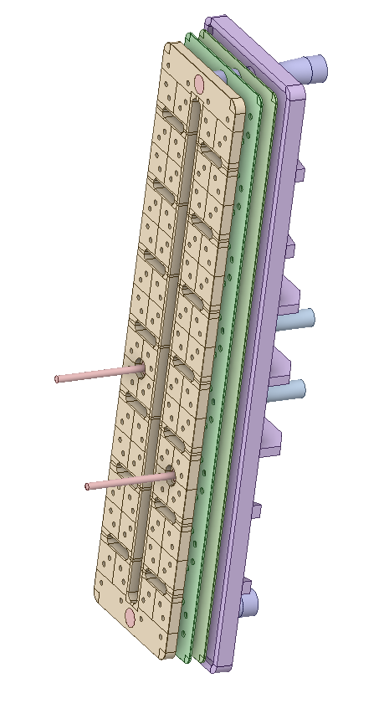
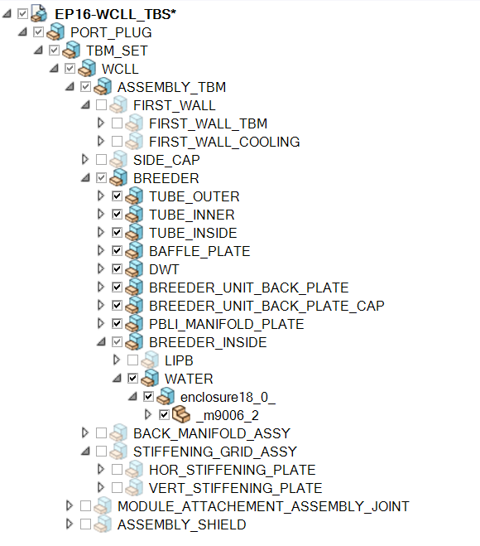
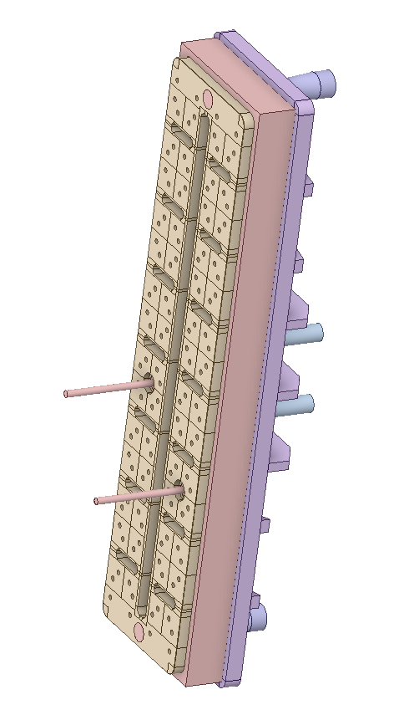
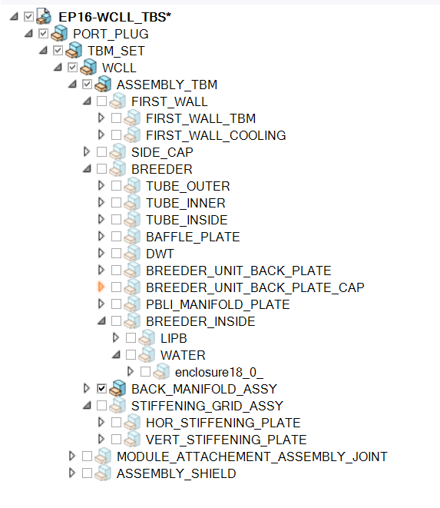
Other example of enclosure
Enclosure definition
Material identification
WCLL manifold
(void filled with water)
Water enclosure

Slide 33
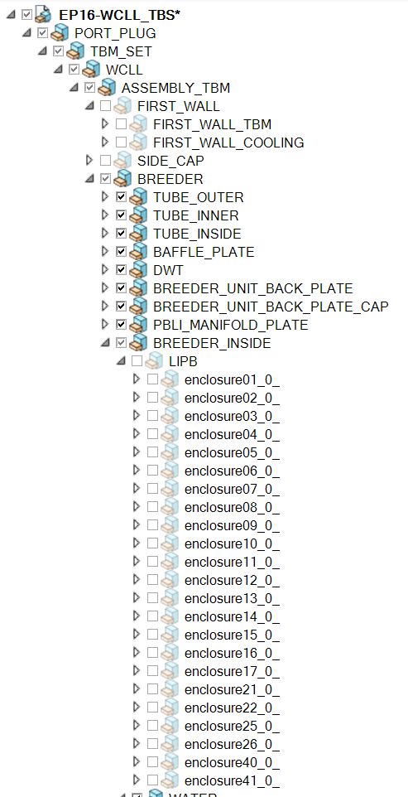
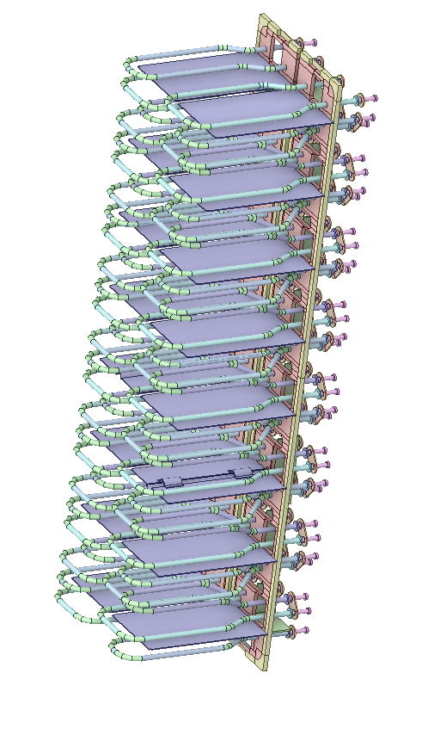
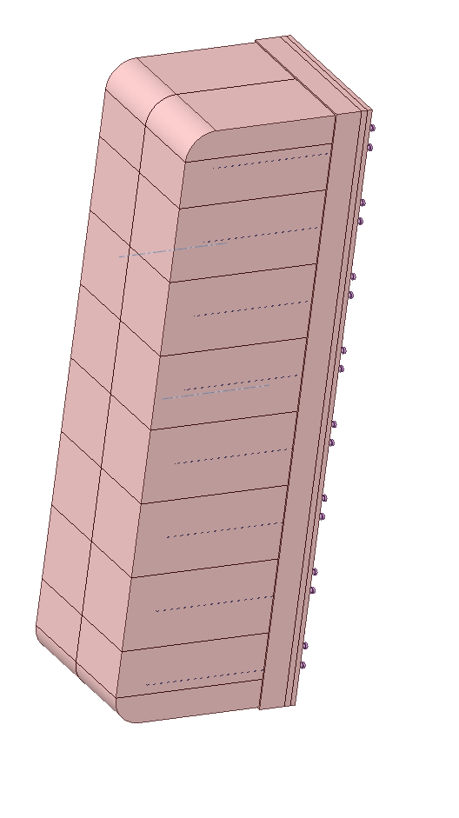
Other example of enclosure
If “sort_enclosure” settings is True, void cells of the enclosures will be located following the “PBLI_MANIFOLD_PLATE” cells in the CSG output file. Otherwise, the cells will be located at the end of the solid cell definition.
Breeder units
Material LiPb
Enclosures

Slide 34
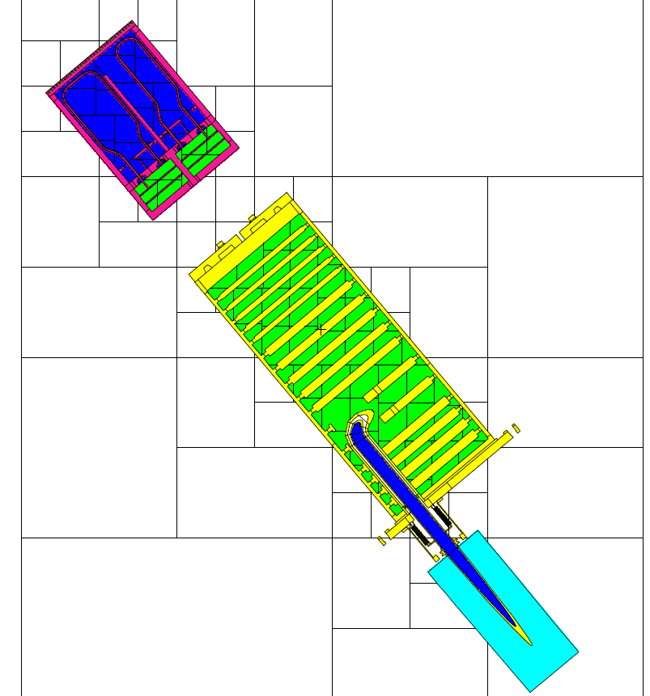
Other example of enclosure
Enclosures to define
LiPb and water

Slide 35
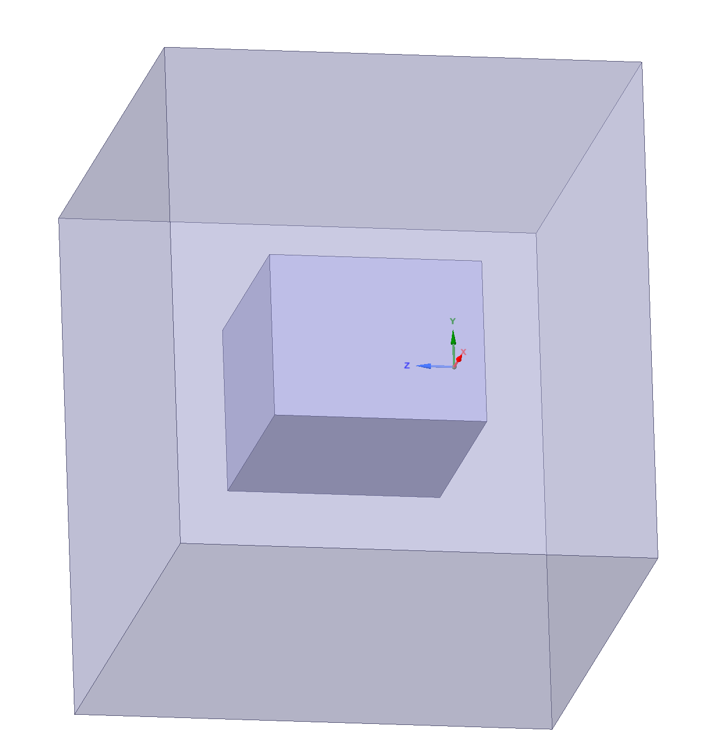
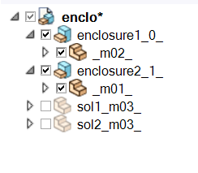
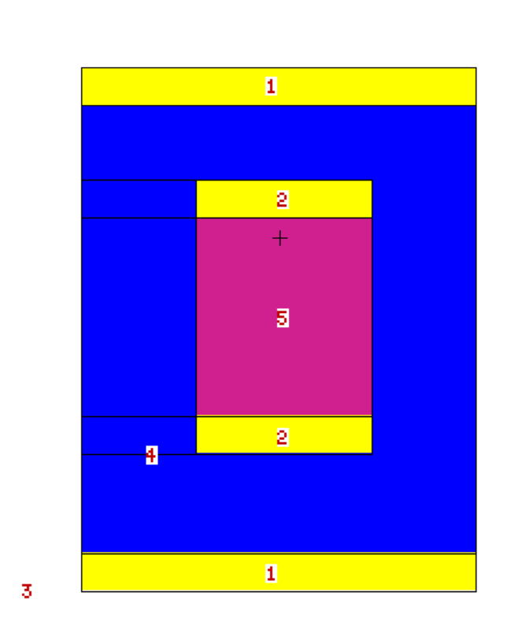
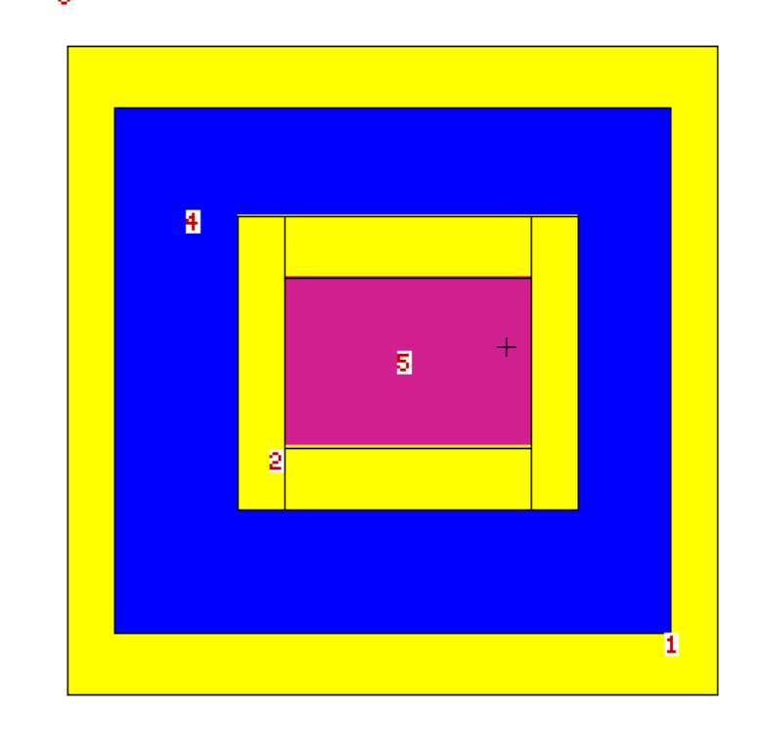
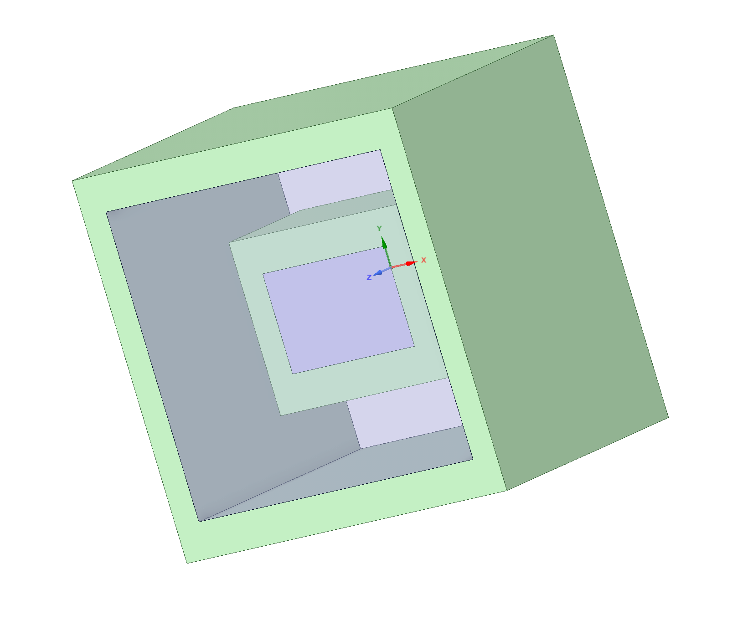
Example of nested enclosures
Nested enclosures
Enclosure 2
XY view
XZ view
Enclosure 1

Slide 36
Debug & log files

Slide 37
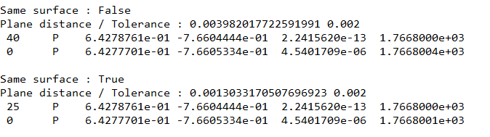
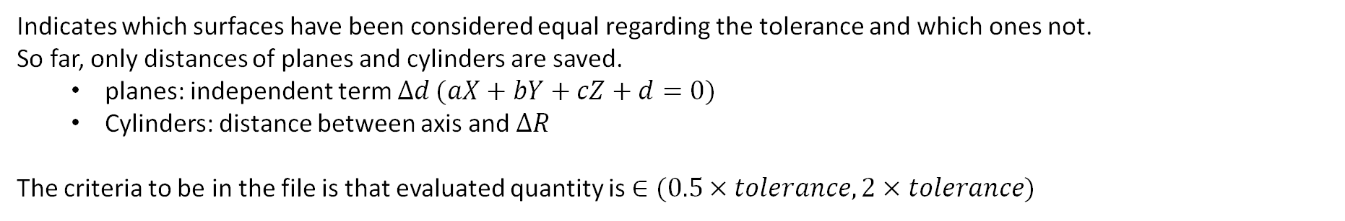
fuzzySurfaces file
Indicates which surfaces have been considered equal regarding the tolerance and which ones not.
So far, only distances of planes and cylinders are saved.
  planes: independent term $Δd (aX+bY+cZ+d=0)$
  Cylinders: distance between axis and $ΔR$
The criteria to be in the file is that evaluated quantity is $∈(0.5×tolerance,2×tolerance)$

Slide 38
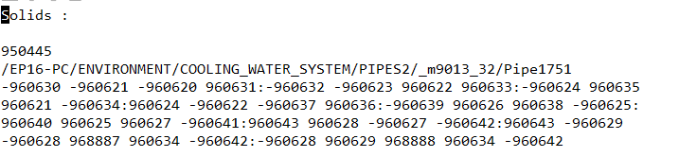
Suspicious solids
“Warning_Solids_definition.txt” file contains information about MC definition of suspicious solids
Cell number
Comment
Cell definition
The suspicious solids are saved in “Suspicious_solids” folder that contains two STEP files for each solid
the original and decomposed (split) version.

Slide 39
Thank you for your attention
GEOUNED code development has been partially supported by the Ministerio de Ciencia e Innovación (MICINN), Spain
under Plan Estatal I+D+i - Retos de la Sociedad, project PID2019-109362RA-I00

